Slide 1



Employee Data Analysis using Excel
Name :Bhavani.N
Register No: 312214888
Department : B.com Computer application
College : Annai Veilankanni’ College For Women
1

Slide 2

PROJECT TITLE
Employee Performance Analysis
using Excel
2

Slide 3


AGENDA
1.Problem Statement
2.Project Overview
3.End Users
4.Our Solution and Proposition
5.Dataset Description
6.Modelling Approach
7.Results and Discussion 8.Conclusion
3

Slide 4

PROBLEM STATEMENT
Background : In many organizations, employee data such as performance
metrics, attendance records, and demographic information are collected but
not systematically analyzed. This data is often stored in spreadsheets but
may not be effectively utilized to provide insights or drive decisions .
Problem: Despite the availability of employee data, the organization lacks a comprehensive analysis to identify trends, make data-driven decisions, and
improve operational efficiency. Currently, manual analysis of this data is time-consuming, prone to errors, and fails to leverage advanced Excel techniques to uncover meaningful insights.
Objectives: The goal of this project is to implement advanced Excel techniques to analyze employee data effectively
Scope: This analysis will focus on existing employee data in Excel spreadsheets, employing techniques such as pivot tables, conditional formatting and advanced charting .
4

Slide 5

PROJECT OVERVIEW
•Project Title: Employee Data Analysis using Excel Technique
•Project Purpose: The purpose of this project is to enhance the analysis of
•employee data through the application of advanced Excel techniques. By
•improving the methods used to process and analyze this data, the project aims •to provide actionable insights that support more informed decision-making
•and operational efficiency within the organization.
•Objectives:
•Automate Data Processing: Implement Excel functions and formulas to
•automate data entry and processing, minimizing manual errors and •improving efficiency.
•Analyze Key Metrics: Utilize pivot tables, data filters, and statistical •functions to analyze performance metrics, attendance patterns, and other
•relevant employee data.
5

Slide 6


• Visualize Data: Create dynamic charts, graphs, and dashboards to visualize data trends
and make complex information easier to interpret
• Generate Insights: Derive actionable insights from the data to support human resources decisions, such as identifying top performer , understanding attendance issues, and planning for professional development
• Benefits:
• Improved Efficiency: Streamlined data processing and reduced manual effort.
• Enhanced Insights: Better understanding of employee performance and trends.
• Data-Driven Decisions: More informed HR decisions based on robust data analysis.
• Visualization Tools: Easy-to-use dashboards and reports that facilitate better communication of insights.

Slide 7

WHO ARE THE END USERS?
. Management Team
. Human Resources (HR) Department
. Finance Department
. Team Leaders and Supervisors
. Employee Relations Specialists
. Data Analysts
. External Consultants
7

Slide 8


OUR SOLUTION AND ITS VALUE PROPOSITION
Our solution involves leveraging advanced Excel
techniques to conduct a comprehensive analysis of employee data. This includes using tools such as
pivot tables, conditional formatting, and dynamic dashboards to process, analyze, and visualize
employee performance metrics, attendance records, and other key data points.
8

Slide 9
Dataset Description
The dataset for this analysis comprises various
employee-related information collected from internal records and stored in Excel spreadsheets. This data
includes metrics related to employee performance, attendance and other relevant attributes.
Data Sources:
Performance Evaluation Records: Contains
performance ratings, feedback scores, and achievement records.

Slide 10
Key data Attributes:
Employee ID: A unique identifier assigned to each employee.
Name: The full name of the employee.
Department: The department in which the employee works.
Performance Ratings: Scores or ratings from performance evaluations, typically on a scale (e.g., 1-5) .
Demographic Information: Age,gender, and other relevant demographic details.

Slide 11


11
THE "WOW" IN OUR SOLUTION
Our solution leverages the full power of Excel’s
advanced features, transforming raw employee data into actionable insights with cutting-edge techniques. From complex pivot tables and
dynamic charts to advanced formulas and data
models, we harness Excel’s capabilities to provide
a level of analysis and visualization that is both
sophisticated and accessible.
3/21/2024 Annual Review

Slide 12
One of the standout features of our solution is the
creation of interactive dashboards. These
dashboards allow users to drill down into specific data points, filter information dynamically, and
view real-time updates. This interactivity ensures that stakeholders can easily explore the data and gain insights tailored to their specific needs
without relying on static reports.
We automate repetitive tasks and streamline data processing through Excel’s automation tools, such as macros and VBA scripts.

Slide 13
MODELLING
Our modelling approach focuses on utilizing advanced Excel techniques to analyse employee data effectively. We aim to uncover insights, identify trends, and provide actionable
recommendations through structured data processing and analysis.
Data Cleaning: Begin by cleaning and preprocessing the data to
ensure accuracy. This includes handling missing values, correcting inconsistencies, and standardizing formats.
Data Integration: Consolidate data from multiple sources (e.g., HR records, performance evaluations) into a single Excel
workbook, ensuring that all relevant attributes are included and aligned.
13

Slide 14
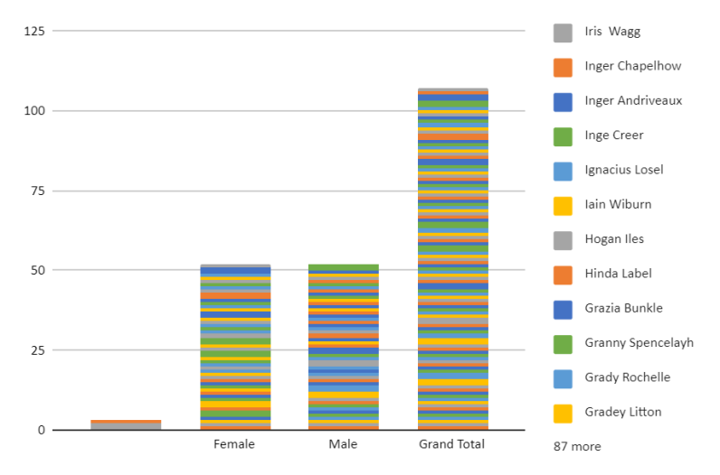
RESULTS
14

Slide 15
conclusion
The application of Excel techniques has proven to be a
powerful and cost-effective approach for analyzing employee data. By transforming raw data into
actionable insights, this analysis supports more strategic
decision-making and contributes to the overall success of the organization. We look forward to seeing how
these insights will be applied to drive improvements and achieve organizational goals.

